Slide 1
Introduction to HTML 5
By Tamal Dey
Assistant Professor,
Dept. of MCA
PESIT

Slide 2
Index
Basics
HTML5 Intro
HTML5 Support
HTML5 Elements
HTML5 Semantics
HTML5 Migration
HTML5 Style Guide
HTML Media
HTML Video
HTML Audio
HTML Plug-ins
HTML YouTube
HTML Graphics
HTML Canvas
HTML SVG

Slide 3
Introduction
HTML5 is the latest and most enhanced version of HTML. Technically, HTML is not a programming language, but rather a markup language.
HTML5 is a core technology markup language of the Internet used for structuring and presenting content for the World Wide Web.
As of October 2014 this is the final and complete fifth revision of the HTML standard of the World Wide Web Consortium (W3C). The previous version, HTML 4, was standardized in 1997.
Notes:
Markup languages are designed for the processing, definition and presentation of text. The language specifies code for formatting, both the layout and style, within a text file. The code used to specify the formatting are called tags. HTMLis a an example of a widely known and used markup language.

Slide 4
History
HTML5 is a mark-up language, has been come into existence around January 2008.
The two major organizations have been involved in developing of HTML5 since its initial time.
One is W3C (World Wide Web Consortium)
Other one is WHATWG (Web Hypertext Application Technology Working Group).
According to these organizations, they have been working on the HTML5 since initial time.

Slide 5
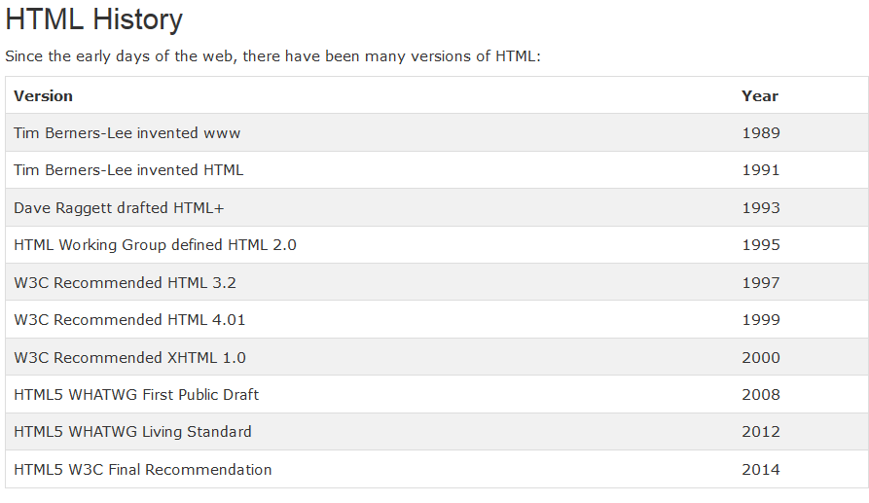

Slide 6
What is Html5 ?
HTML5 is the newest version of HyperText Markup Language.
The standard version came into existence in 1995, when HTML 2.0 was announced. Later after two years HTML 3.0 and after two years HTML 4.01 was announced and still we are using the milestone of HTML 4.01.
The First Draft of HTML5 Was announced in January 2008 and amazingly HTML5 has a broad browser support.
In 2012, WHATWG and W3C decided on a separation:

Slide 7
WHATWG will develop HTML as a "Living Standard".
A living standard is never fully complete, but always updated and improved. New features can be added, but old functionality can not be removed.
The WHATWG Living Standard was published in 2012, and is continuously updated.
W3C will develop a definitive HTML5 and XHTML5 standard, as a "snapshot" of WHATWG.
The W3C HTML5 recommendation was released 28. October 2014.

Slide 8
HTML 5 Benefits
Present of Web designing makes easier with the development of HTML5.
The use of Photoshop and Flash application use has been reduced by development of HTML5,
Use <details> and <summary> tag for show and hide function of Java Script. We need not to put a long affords to code this thing.
Apart from this feature we can use the 3D image with <canvas>, the special designed paragraph with <article> and many more.

Slide 9
HTML 5 Syntax Rules
HTML 5 does not have the same syntax rules as XHTML where we needed lower case tag names, quoting the attributes, an attribute had to have a value and to close all empty elements.
But HTML5 is coming with lots of flexibility and would support the followings:
Uppercase tag names.
Quotes are optional for attributes.
Attribute values are optional.
Closing empty elements are optional.
br, hr, link and meta etc

Slide 10
HTML5 removes extra information required and you can use simply following syntax:
<script src="scriptfile.js"></script>
HTML5 removes extra information required and you can use simply following syntax:
<link rel="stylesheet“ href="stylefile.css">

Slide 11
HTML5 - New Attribute Syntax
HTML5 allows four different syntax for attributes.
This example demonstrates the different syntax used in an <input> tag:
Example
Empty <input type="text" value="John" disabled>
Unquoted<input type="text" value=John>
Double-quoted<input type="text" value="John Doe">
Single-quoted<input type="text" value='John Doe'>
In HTML5, all four syntaxes may be used, depending on what is needed for the attribute.

Slide 12
HTML5 Features
Simpler DOCTYPE declaration.
<!DOCTYPE html>
XML namespaces and attributes no longer needed.
The character encoding (charset) declaration
<meta charset="UTF-8">
Unicode Transformation Format
The default character encoding in HTML5 is UTF-8.
Easier and shorter stylesheet and script declaration.
No more self closing syntax.

Slide 13
Minimum HTML5 Document
<!DOCTYPE html> <html lang=“en”> <head> <meta charset="UTF-8"> <title>Title of the document</title> </head> <body> Content of the document...... </body> </html>

Slide 14
New HTML5 Elements
The most interesting new elements are:
New semantic elements like <header>, <footer>, <article>, and <section>.
New form control attributes like number, date, time, calendar, and range.
New graphic elements: <svg> and <canvas>.
New multimedia elements: <audio> and <video>.

Slide 15
New HTML5 API's (Application Programming Interfaces)
API: Provides set of routines, protocols, and tools for building software applications
The most interesting new API's are:
HTML Geolocation: Now visitors can choose to share their physical location with your web application.
HTML Drag and Drop: "grab" an object and drag it to a different location.
HTML Local Storage : To achieve without resorting to third-party plug-in. Store data locally within the user's browser.

Slide 16
HTML Application Cache: application cache it is easy to make an offline version of a web application, by creating a cache manifest file.
Advantages
Offline browsing
Speed - cached resources load faster
Reduced server load
HTML Web Workers: web worker is a JavaScript running in the background, without affecting the performance of the page.
HTML SSE : Server-Sent Events allow a web page to get updates from a server.

Slide 17
HTML 4.01 elements are removed from HTML5:
<acronym>
<applet>
<basefont>
<big>
<center>
<dir>
<font>
<frame>
<frameset>
<noframes>
<strike>
<tt>

Slide 18
What are Semantic Elements?
A semantic element clearly describes its meaning to both the browser and the developer.
Examples of non-semantic elements: <div> and <span> - Tells nothing about its content.
Examples of semantic elements: <form>, <table>, and <img> - Clearly defines its content.
<div id="nav">
<div class="header">
<div id="footer">
Semantic elements are elements with a meaning

Slide 19
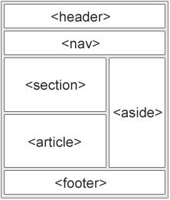
HTML5 semantic elements
<article>
<aside>
<details>
<figcaption>
<figure>
<footer>
<header>
<main>
<mark>
<nav>
<section>
<summary>
<time>

Slide 20
HTML5 -Block Elements
HTML5 defines eight new semantic HTML elements.
All these are block-level elements.
To secure correct behaviour in older browsers, you can set the CSS display property to block:
header, section, footer, aside, nav, main, article, figure { display: block; }
Visit http://dustwell.com/div-span-inline-block.html
Difference between Block, Inline and Inline-Block elements

Slide 21
HTML5 New Elements
<article> : specifies independent, self-contained content.
An article should make sense on its own, and it should be possible to read it independently from the rest of the web site.
Used in a report in website with reusable facility
Here is the Syntax
<article> .... </article>
<article> element can be used:
Forum post
Blog post
Newspaper article
submitted comment etc

Slide 22
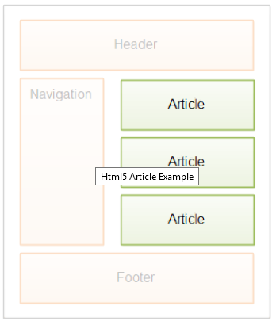
Better design and format of article element, you will have to use some css code

Slide 23
<section> element defines a section in a document.
According to W3C's HTML5 documentation: "A section is a related grouping of content, typically with a heading."
A Web site's home page could be split into sections for introduction, content, and contact information.

Slide 24
Nesting Semantic Elements
In the HTML5 standard, the <article> element defines a complete, self-contained block of related elements.
The <section> element is defined as a block of related elements.
Can we use the definitions to decide how to nest elements? No, we cannot!
On the Internet, you will find HTML pages with <section> elements containing <article> elements, and <article> elements containing <sections> elements.
You will also find pages with <section> elements containing <section> elements, and <article> elements containing <article> elements.
E.g. Newspaper: The sports articles in the sports section, have a technical section in each article.

Slide 25
Difference Between <article> <section> and <div>
<section> element is defined as a block of related elements.
<article> element is defined as a complete, self-contained block of related elements.
<div> element is defined as a block of children elements.

Slide 26
<aside> : Defines some content aside from the page content it is placed in.
The aside content should be related to the surrounding content.
The <aside> content could be placed as a sidebar in an article.
Syntax
<aside> .... </aside>

Slide 27
bdi- Bi-Directional Isolation
<bdi>: Defines a part of text that might be formatted in a different direction from other text elements in bidirectional content arranging.
Write the Hebrew or Urdu fonts, it shows from the opposite side of the general fonts. So browser behaviour directly change for that particular text.
Isolate the usernames from the surrounding text-direction settings
This element is useful when embedding user-generated content with an unknown directionality.
Syntax:
<bdi> .... </bdi>

Slide 28
<details>: Defines additional details that the user can view or hide
This element shouldn't be used in footnotes. This element is used as the parent of <summary> element
The <details> tag specifies additional details that the user can view or hide on demand.
The <details> tag can be used to create an interactive widget that the user can open and close. Any sort of content can be put inside the <details> tag.

Slide 29
<summary>: Tag defines a visible heading for the <details> element. The heading can be clicked to view/hide the details.

Slide 30
The <figure> Defines self-contained content, like illustrations, diagrams, photos, code listings, etc.
This element is followed by it's child, <figcaption> element.
The <figcaption> Defines a caption for a <figure> element

Slide 31
<header> Defines a header for the document or a section
A <footer> element normally holds data about its area,
E.g.- who thought of it, connections to related records, copyright information, and so forth.

Slide 32
The <hgroup> element is commonly used to gathering a set of one or more h1-h6 elements — to gathering, for instance, a segment title and a going with subtitle.

Slide 33
The <nav> element speaks to a segment of a page that connections to different pages or to parts inside the page: an area with navigation joins.
Not all gatherings of connections on a page need to be in a <nav> element just areas that comprise of real navigation squares are suitable for the <nav> element.

Slide 34
<main> : specifies the main content of a document.
The content inside the <main> element should be unique to the document. It should not contain any content that is repeated across documents such as sidebars, navigation links, copyright information, site logos, and search forms.
Note: There must not be more than one <main> element in a document. The <main> element must NOT be a descendant of an <article>, <aside>, <footer>, <header>, or <nav> element.

Slide 35
Adding New Elements to HTML
Add any new element <myHero> to HTML with a browser trick.
JavaScript statement document.createElement("myHero") is added
newelement.html
Internet Explorer 8 and earlier, does not allow styling of unknown elements.
Try Skeleton.html

Slide 36
<mark> tag defines marked text.
Use the <mark> tag if you want to highlight parts of your text.
<time> tag defines a human-readable date/time.
This element can also be used to encode dates and times in a machine-readable way so that user agents can offer to add birthday reminders or scheduled events to the user's calendar, and search engines can produce smarter search results.

Slide 37
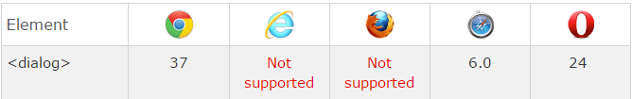
<dialog> : Defines a dialog box or window
The <dialog> element makes it easy to create popup dialogs and modals on a web page.
open: New in HTML5.
Specifies that the dialog element is active and that the user can interact with it

Slide 38

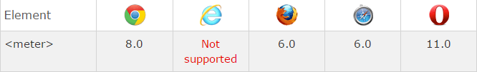
<meter> tag defines a scalar measurement within a known range, or a fractional value. This is also known as a gauge (Form an estimate of (quantities or time).
Examples: Disk usage, the relevance of a query result, etc.
Note: The <meter> tag should not be used to indicate progress. For progress bars, use the <progress> tag.

Slide 39

<progress> tag represents the progress of a task.
Use the <progress> tag in conjunction with JavaScript to display the progress of a task.
Attributes
max number: Specifies how much work the task requires in total
value number Specifies how much of the task has been completed
Notes:
Tip: Use the <progress> tag in conjunction with JavaScript to display the progress of a task.
Note: The <progress> tag is not suitable for representing a gauge (e.g. disk space usage or relevance of a query result). To represent a gauge, use the <meter> tag instead.
Gauge: Instrument that measures and gives a visual display of the amount, level, or contents of something.

Slide 40
`
The <wbr> (Word Break Opportunity) tag specifies where in a text it would be ok to add a line-break.
Tip: Defines a possible line-break. When a word is too long, or you are afraid that the browser will break your lines at the wrong place, you can use the <wbr> element to add word break opportunities.

Slide 41
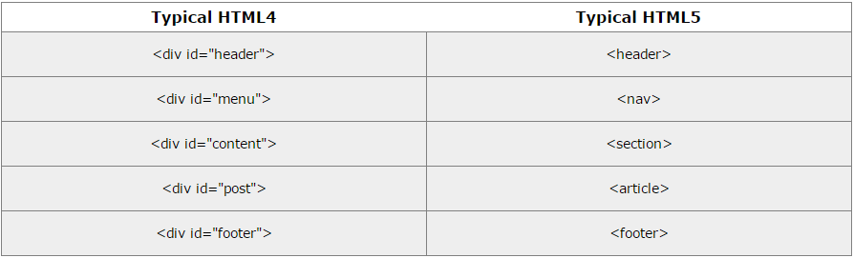
Migration from HTML4 to HTML5
Migration has been done without destroying anything of the original content or structure.

Slide 42
Add The Shiv
HTML5 semantic elements are supported in all modern browsers.
In addition, you can "teach" older browsers how to handle "unknown elements".
Add the shiv for Internet Explorer support:
In <head> part
<!--[if lt IE 9]>
<script src="http://html5shiv.googlecode.com/svn/trunk/html5.js">
</script>
<![endif]-->

Slide 43
New Form Elements
<datalist>: Defines pre-defined options for input controls
<keygen>: Defines a key-pair generator field (for forms)
<output>: Defines the result of a calculation

Slide 44

<datalist> tag specifies a list of pre-defined options for an <input> element.
The <datalist> tag is used to provide an "autocomplete" feature on <input> elements. Users will see a drop-down list of pre-defined options as they input data.
Use the <input> element's list attribute to bind it together with a <datalist> element.

Slide 45
<keygen> tag specifies a key-pair generator field used for forms.
When the form is submitted, the private key is stored locally, and the public key is sent to the server.
<output> tag represents the result of a calculation (like one performed by a script).

Slide 46
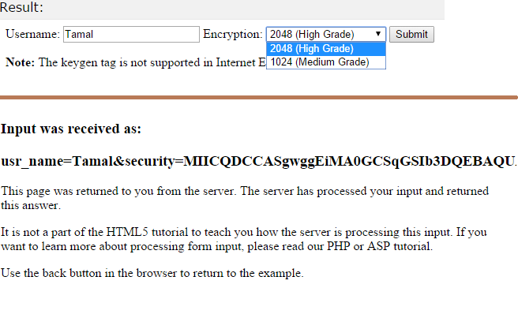
`

Slide 47
HTML 4.1 Input Types
Button
Checkbox
File
Image
Password
Radio
Reset
Submit
Text
Tags
Textarea
Select
Option

Slide 48
HTML 5 Input Types
color
date
datetime
datetime-local
email
Month
number
range
search
tel
time
url
week

Slide 49
Input Type: number
<input type="number"> is used for input fields that should contain a numeric value.
You can set restrictions on the numbers.
Depending on browser support, the restrictions can apply to the input field.
Input Type: range
The <input type="range"> is used for input fields that should contain a value within a range.
Depending on browser support, the input field can be displayed as a slider control.

Slide 50
Input Type: color
The <input type="color"> is used for input fields that should contain a color.
Depending on browser support, a color picker can show up in the input field.
Input Type: date
The <input type="date"> is used for input fields that should contain a date.
Depending on browser support, a date picker can show up in the input field.

Slide 51
Input Type: month
<input type="month"> allows the user to select a month and year.
Depending on browser support, a date picker can show up in the input field.
Input Type: week
The <input type="week"> allows the user to select a week and year.
Depending on browser support, a date picker can show up in the input field.

Slide 52
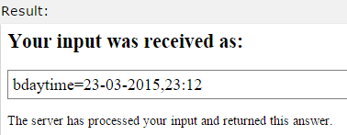
Input Type: time
The <input type="time"> allows the user to select a time (no time zone).
Depending on browser support, a time picker can show up in the input field.
Input Type: datetime (removed)
<input type="datetime"> allows the user to select a date and time (with time zone).

Slide 53
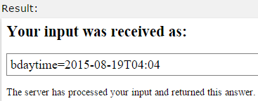
Input Type: datetime-local
<input type="datetime-local"> allows the user to select a date and time (no time zone).
Depending on browser support, a date picker can show up in the input field.

Slide 54
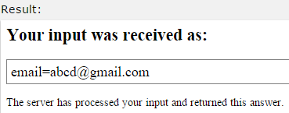
Input Type: email
The <input type="email"> is used for input fields that should contain an e-mail address.
Depending on browser support, the e-mail address can be automatically validated when submitted.
Some smart phones recognize the email type, and adds ".com" to the keyboard to match email input.

Slide 55
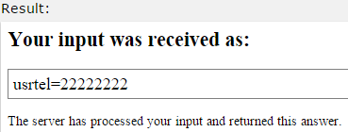
Input Type: search
The <input type="search"> is used for search fields (a search field behaves like a regular text field).
Input Type: tel
The <input type="tel"> is used for input fields that should contain a telephone number.
The tel type is currently supported only in Safari 8.

Slide 56
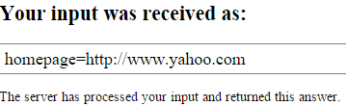
Input Type: url
The <input type="url"> is used for input fields that should contain a URL address.
Depending on browser support, the url field can be automatically validated when submitted
Some smartphones recognize the url type, and adds ".com" to the keyboard to match url input.

Slide 57
Attributes of HTML 4.0
The readonly attribute specifies that the input field is read only (cannot be changed)
The value attribute specifies the initial value for an input field
disabled attribute specifies that the input field is disabled.
A disabled element is un-usable and un-clickable.
Disabled elements will not be submitted.
size attribute increase length of the input field

Slide 58
New Input Attributes HTML 5
autocomplete
autofocus
form
formaction
formenctype
formmethod
formnovalidate
formtarget
height and width
list
min and max
multiple
pattern (regexp)
placeholder
required
step

Slide 59
autocomplete Attribute
autocomplete attribute specifies whether a form or input field should have autocomplete on or off.
When autocomplete is on, the browser automatically complete values based on value that the user has entered before.
Tip: It is possible to have autocomplete "on" for the form, and "off" for specific input fields, or vice versa.
The autocomplete attribute works with <form> and the following <input> types: text, search, url, tel, email, password, datepickers, range, and color

Slide 60
autofocus Attribute
The autofocus attribute is a boolean attribute.
When present, it specifies that an <input> element should automatically get focus when the page loads.
form Attribute
The form attribute specifies one or more forms an <input> element belongs to.
Tip: To refer to more than one form, use a space-separated list of form ids.

Slide 61
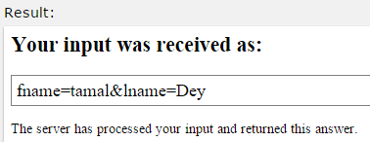

formaction Attribute
The formaction attribute specifies the URL of a file that will process the input control when the form is submitted.
The formaction attribute overrides the action attribute of the <form> element.
The formaction attribute is used with type="submit" and type="image".

Slide 62
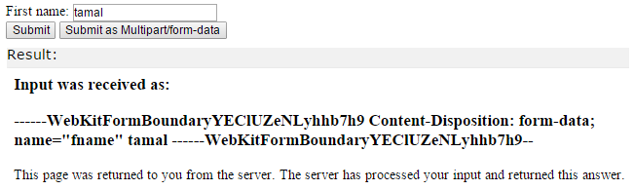
formenctype Attribute
The formenctype attribute specifies how the form-data should be encoded when submitting it to the server (only for forms with method="post")
The formenctype attribute overrides the enctype attribute of the <form> element.
The formenctype attribute is used with type="submit" and type="image".

Slide 63
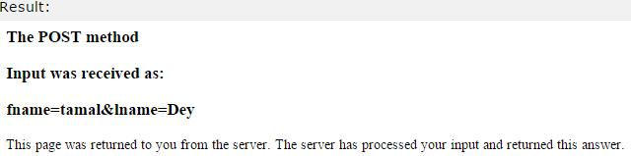
formmethod Attribute
The formmethod attribute defines the HTTP method for sending form-data to the action URL.
The formmethod attribute overrides the method attribute of the <form> element.
The formmethod attribute can be used with type="submit" and type="image".

Slide 64

novalidate Attribute
The novalidate attribute is a <form> attribute
When present, novalidate specifies that form data should not be validated when submitted.
The novalidate attribute is a boolean attribute.
When present, it specifies that the <input> element should not be validated when submitted.
The formnovalidate attribute overrides the novalidate attribute of the <form> element.
The formnovalidate attribute can be used with type="submit".
formnovalidate Attribute

Slide 65
formtarget Attribute
The formtarget attribute specifies a name or a keyword that indicates where to display the response that is received after submitting the form.
The formtarget attribute overrides the target attribute of the <form> element.
The formtarget attribute can be used with type="submit" and type="image".

Slide 66
height and width Attributes
The height and width attributes specify the height and width of an <input> element.
The height and width attributes are only used with <input type="image">.
<input type="image" src="img_submit.gif" alt="Submit" width="48" height="48">
list Attribute
The list attribute refers to a <datalist> element that contains pre-defined options for an <input> element.

Slide 67
multiple Attribute
The multiple attribute is a boolean attribute.
When present, it specifies that the user is allowed to enter more than one value in the <input> element.
The multiple attribute works with the following input types: email, and file.
Select images:
<input type="file" name="img" multiple>
Tip: For <input type="file">: to select multiple files, hold down the CTRL or SHIFT key while selecting.
Tip: For <input type="email” multiple >: separate each email with a comma, like: mail@example.com, mail2@example.com, mail3@example.com in the email field.

Slide 68
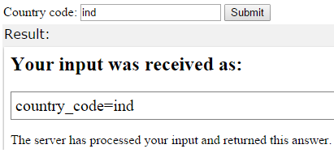
pattern Attribute
The pattern attribute specifies a regular expression that the <input> element's value is checked against.
The pattern attribute works with the following input types: text, search, url, tel, email, and password.

Slide 69
placeholder Attribute
The placeholder attribute specifies a hint that describes the expected value of an input field (a sample value or a short description of the format).
The hint is displayed in the input field before the user enters a value.
The placeholder attribute works with the following input types: text, search, url, tel, email, and password.

Slide 70
required Attribute
The required attribute is a boolean attribute.
When present, it specifies that an input field must be filled out before submitting the form.
The required attribute works with the following input types: text, search, url, tel, email, password, date pickers, number, checkbox, radio, and file.

Slide 71
step Attribute
The step attribute specifies the legal number intervals for an <input> element.
Example: if step="3", legal numbers could be -3, 0, 3, 6, etc.
Tip: The step attribute can be used together with the max and min attributes to create a range of legal values.
The step attribute works with the following input types: number, range, date, datetime, datetime-local, month, time and week.

Slide 72
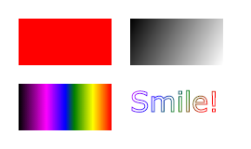
HTML5 Graphics Canvas
The HTML <canvas> element is used to draw graphics on a web page.
Here It shows four elements: a red rectangle, a gradient rectangle, a multicolor rectangle, and a multicolor text.
The Canvas 2d drawing API, is like a scriptable image tag, as canvas is like an image tag that JavaScript can customize.
<canvas id="a"></canvas>

Slide 73
What is HTML Canvas?
The HTML <canvas> element is used to draw graphics, on the fly, via scripting (usually JavaScript).
The <canvas> element is only a container for graphics. You must use a script to actually draw the graphics.
Canvas has several methods for
drawing paths
boxes
circles
text,
adding images

Slide 74
Canvas Examples
A canvas is a rectangular area on an HTML page. By default, a canvas has no border and no content.
The markup looks like this:
<canvas id="myCanvas” width="200" height="100">
</canvas>
Note: Always specify an id attribute (to be referred to in a script), and a width and height attribute to define the size of the canvas.
To add a border, use the style attribute
style="border:1px solid #000000;"

Slide 75
HTML Graphics
<canvas> element has no drawing abilities of its own (it is only a container for graphics) - you must use a script to actually draw the graphics.
getContext() method returns an object that provides methods and properties for drawing on the canvas.
The properties and methods of the getContext("2d") object, which can be used to draw text, lines, boxes, circles, and more - on the canvas.

Slide 76
Colors, Styles, and Shadows
Property | Description
fillStyle | Sets or returns the color, gradient, or pattern used to fill the drawing
shadowColor | Sets or returns the color to use for shadows
shadowBlur | Sets or returns the blur level for shadows
shadowOffsetX | Sets or returns the horizontal distance of the shadow from the shape
shadowOffsetY | Sets or returns the vertical distance of the shadow from the shape

Slide 77
Rectangles
Method | Description
rect() | Creates a rectangle
fillRect() | Draws a "filled" rectangle
strokeRect() | Draws a rectangle (no fill)
clearRect() | Clears the specified pixels within a given rectangle
Method | Description
createLinearGradient() | Creates a linear gradient (to use on canvas content)
createPattern() | Repeats a specified element in the specified direction
addColorStop() | Specifies the colors and stop positions in a gradient object

Slide 78
addclorstop()
The addColorStop() method specifies the colors and position in a gradient object.
The addColorStop() method is used together with createLinearGradient() or createRadialGradient().
Note: You can call the addColorStop() method multiple times to change a gradient.
If you omit this method for gradient objects, the gradient will not be visible. You need to create at least one color stop to have a visible gradient.
JavaScript syntax: gradient.addColorStop(stop,color);

Slide 79
Paths
Method | Description
fill() | Fills the current drawing (path)
moveTo() | Moves the path to the specified point in the canvas, without creating a line
stroke() | Actually draws the path you have defined
lineTo() | Adds a new point and creates a line from that point to the last specified point in the canvas
beginPath() | Begins a path, or resets the current path
arc() | Creates an arc/curve (used to create circles, or parts of circles)
clip() | Clips a region of any shape and size from the original canvas

Slide 80
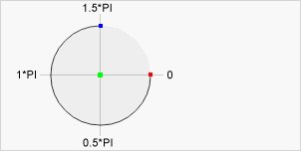
arc
JavaScript syntax:
context.arc(x,y,r,sAngle,eAngle,clockwise);
Tip: To create a circle with arc():
Set start angle to 0
end angle to 2*Math.PI.
Center arc(100,75,50,0*Math.PI,1.5*Math.PI)
Start angle: arc(100,75,50,0,1.5*Math.PI)
End angle: arc(100,75,50,0*Math.PI,1.5*Math.PI)

Slide 81
Text
Property | Description
font | Sets or returns the current font properties for text content
textAlign | Sets or returns the current alignment for text content
textBaseline | Sets or returns the current text baseline used when drawing text
Method | Description
fillText() | Draws "filled" text on the canvas
strokeText() | Draws text on the canvas (no fill)
measureText() | Returns an object that contains the width of the specified text

Slide 82
Image Drawing- Canvas
Method Description drawImage() Draws an image, canvas, or video onto the canvas
Note: call drawImage() from window.onload()
or
from document.getElementById("imageID").onload
JavaScript Syntax: context.drawImage(img, x, y);

Slide 83
What is SVG?
SVG stands for Scalable Vector Graphics is an XML-based vector image format for two-dimensional graphics with support for interactivity and animation.
The SVG specification is an open standard developed by the World Wide Web Consortium (W3C) since 1999. SVG images and their behaviors are defined in XML text files
SVG is used to define graphics for the Web <svg> element (introduced in HTML5) is a container for SVG graphics.
SVG has several methods for drawing paths, boxes, circles, text, and graphic images.

Slide 84
Advantages of SVG
SVG graphics do NOT lose any quality if they are zoomed or resized
Every element and every attribute in SVG files can be animated
Main competitor to SVG is Flash
SVG images can be created and edited with any text editor
SVG images can be searched, indexed, scripted, and compressed
SVG images are scalable
SVG files are open standard and pure XML

Slide 85
SVG predefined shape
Circle <circle>
Rectangle <rect>
Ellipse <ellipse>
Line <line>
Polygon <polygon>
Polyline <polyline>
Path <path>
Text
Stroking

Slide 86
SVG Circle
An SVG image begins with an <svg> element
Define width and height of the SVG image
The <circle> element is used to draw a circle
The cx and cy attributes coordinates of the center of the circle. If cx and cy are omitted, the circle's center is set to (0, 0)
The r attribute defines the radius of the circle
The stroke and stroke-width attributes control outline of a shape appears with 8px yellow "border"
The fill attribute refers to the color inside the circle to red
The closing </svg> tag closes the SVG image

Slide 87
HTML Multimedia
Multimedia comes in many different formats. It can be almost anything you can hear or see.
Examples: Pictures, music, sound, videos, records, films, animations, and more.
Web pages often contain multimedia elements of different types and formats.
First web browsers had support for text only, limited to a single font in a single color.
Then support for pictures , sounds, animations, and videos and Plug-ins (extra helper programs ) is handled differently by various browsers.
HTML5 multimedia promises an easier future for multimedia.

Slide 88
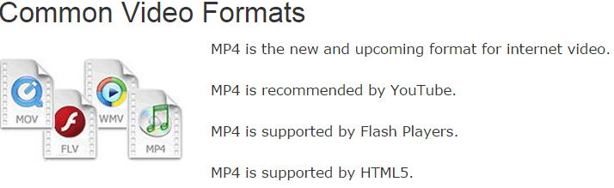
Multimedia Formats
Multimedia elements (like sounds or videos) are stored in media files.
Multimedia files also have their own formats and different extensions like: .swf, .wav, .mp3, .mp4, .mpg, .wmv, and .avi.

Slide 89
Sound Formats
Format | File | Description
MIDI | .mid .midi | MIDI (Musical Instrument Digital Interface). Main format for all electronic music devices like synthesizers and PC sound cards. MIDI files do not contain sound, but digital notes that can be played by electronics. Plays well on all computers and music hardware, but not in web browsers.
RealAudio | .rm .ram | RealAudio. Developed by Real Media to allow streaming of audio with low bandwidths. Does not play in web browsers.
WMA | .wma | WMA (Windows Media Audio). Developed by Microsoft. Commonly used in music players. Plays well on Windows computers, but not in web browsers.
AAC | .aac | AAC (Advanced Audio Coding). Developed by Apple as the default format for iTunes. Plays well on Apple computers, but not in web browsers.

Slide 90
Format | File | Description
WAV | .wav | WAV. Developed by IBM and Microsoft. Plays well on Windows, Macintosh, and Linux operating systems. Supported by HTML5.
Ogg | .ogg | Ogg. Developed by the Xiph.Org Foundation. Supported by HTML5.
MP3 | .mp3 | MP3 files are actually the sound part of MPEG files. MP3 is the most popular format for music players. Combines good compression (small files) with high quality. Supported by all browsers.
MP4 | .mp4 | MP4 is a video format, but can also be used for audio. MP4 video is the upcoming video format on the internet. This leads to automatic support for MP4 audio by all browsers.
Note: Only MP3, WAV, and Ogg audio are supported by the newest HTML5 standard.

Slide 91

Audio on the Web
To play an audio file in HTML, use the <audio> element
The controls attribute adds audio controls, like play, pause, and volume.
Text between the <audio> and </audio> tags will display in browsers that do not support the <audio> element.
Multiple <source> elements can link to different audio files. The browser will use the first recognized format.

Slide 92
Video Formats
Format | File | Description
MPEG | .mpg .mpeg | MPEG. Developed by the Moving Pictures Expert Group. The first popular video format on the web. Used to be supported by all browsers, but it is not supported in HTML5 (See MP4).
AVI | .avi | AVI (Audio Video Interleave). Developed by Microsoft. Commonly used in video cameras and TV hardware. Plays well on Windows computers, but not in web browsers.
WMV | .wmv | WMV (Windows Media Video). Developed by Microsoft. Commonly used in video cameras and TV hardware. Plays well on Windows computers, but not in web browsers.
QuickTime | .mov | QuickTime. Developed by Apple. Commonly used in video cameras and TV hardware. Plays well on Apple computers, but not in web browsers. (See MP4)

Slide 93
Format | File | Description
RealVideo | .rm .ram | RealVideo. Developed by Real Media to allow video streaming with low bandwidths. It is still used for online video and Internet TV, but does not play in web browsers.
Flash | .swf .flv | Flash. Developed by Macromedia. Often requires an extra component (plug-in) to play in web browsers.
Ogg | .ogg | Theora Ogg. Developed by the Xiph.Org Foundation. Supported by HTML5.
WebM | .webm | WebM. Developed by the web giants, Mozilla, Opera, Adobe, and Google. Supported by HTML5.
MPEG-4 or MP4 | .mp4 | MP4. Developed by the Moving Pictures Expert Group. Based on QuickTime. Commonly used in newer video cameras and TV hardware. Supported by all HTML5 browsers. Recommended by YouTube.
Note: Only MP4, WebM, and Ogg video are supported by the newest HTML5 standard.

Slide 94
How it Works
The controls attribute adds video controls, like play, pause, and volume.
For video include width and height attributes.
If height and width are not set, the browser does not know the size of the video. The effect will be that the page will change (or flicker) while the video loads.
Text between the <video> and </video> tags will only display in browsers that do not support the <video> element.
Multiple <source> elements can link to different video files. The browser will use the first recognized format.

Slide 95
Video - Methods, Properties, and Events
start a video automatically use the autoplay attribute (does not work in Safari and Opera, or in mobile devices)
HTML5 defines methods that allows you to load, play, and pause videos, as well as setting duration and DOM volume.

Slide 96
HTML Plug-ins
Helper applications , the purpose of a plug-in, is to extend the functionality of the HTML browser
Examples of well-known plug-ins are Java applets.
Plug-ins can be added to web pages with the <object> tag or the <embed> tag.
Plug-ins can be used for many purposes:
Display maps
Scan for viruses
Verify your bank id etc.
<object> element defines an embedded object within an HTML document, used to embed plug-ins (like Java applets, PDF readers, Flash Players) in web pages

Slide 97
The <embed> element also defines an embedded object within an HTML document.
<embed> element does not have a closing tag. It can not contain alternative text.
<object> and <embed> can be used to load HTML page, images and embed plug-ins

Slide 98
HTML - YouTube Videos
The easiest way to play videos in HTML, is to use YouTube.
Different versions of different browsers support different video formats.
Converting videos to different format can be difficult and time consuming.
An easier solution might be to let YouTube play the videos in your web page.
YouTube will display a video id (like XGSy3_Czz8k), when you save (or play) a video.
use this id, and refer to your video in HTML.

Slide 99
To play your video on a web page, do the following:
Upload the video to YouTube
Take a note of the video id
Define an <iframe> element in your web page
Let the src attribute point to the video URL
Use the width and height attributes to specify the dimension of the player
Add any other parameters to the URL

Slide 100
YouTube Parameters
autohide: Value 0 (player control visible),1 (hides) ,2 (default)
autoplay : Value 0,1
control: Value 0,1,2 (does not load initially)
loop: Value 0,1
playlist : comma separated list of videos (url)

Slide 101
End

